Slide 1
Topic: Measurement
EQ: How do we calculate the area of composite shapes?
Get your VIVO’s
Topic and EQ in Interactive Notebook
NO PHONES OR EAR BUDS
Have a go:
Notes:
Under the Have a go you may want to write some review questions on Perimeter and Area

Slide 2
24
7
30
Date
Measurement
EQ: How do we calculate the area of composite shapes?
What are composite shapes?
Compound shape: a 2D shape made up of many shapes
5

Slide 3
24
7
30
Date
Measurement
EQ: How do we calculate the area of composite shapes?
5

Slide 4
24
7
30
Date
Measurement
EQ: How do we calculate the area of composite shapes?
How do we find the area of composite shapes?
To find the area of compound shapes, split them up into their composite shapes.
Find the area of each shape, then add them together
5

Slide 5
I Do
8cm
Area A = 8 x 5
= 40cm²
A
5cm
Area B = 11 x 2
= 22cm²
B
11cm
Total Area = 40 + 22
= 62cm²
2cm

Slide 6
We Do

Slide 7
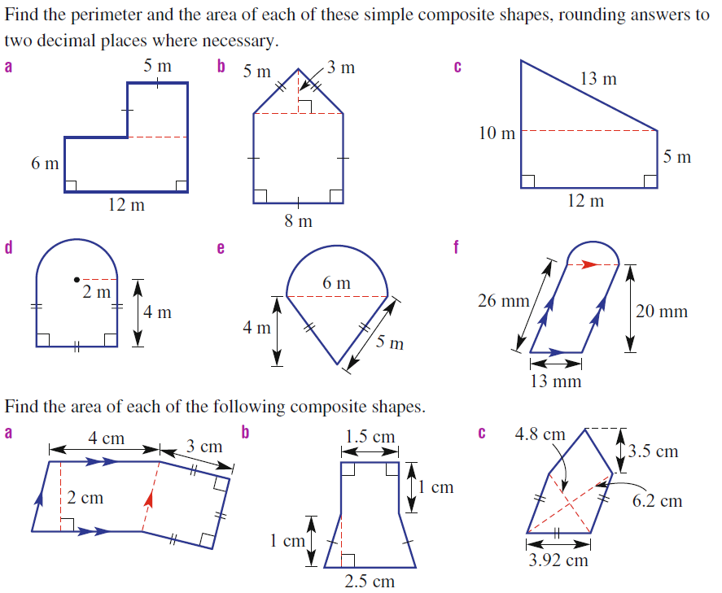
You Do

Slide 8
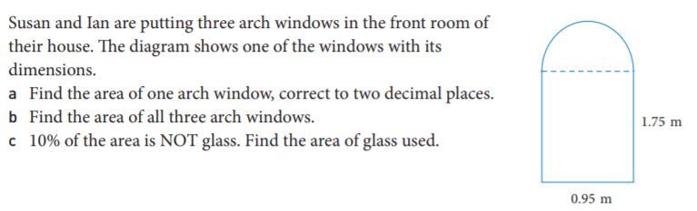
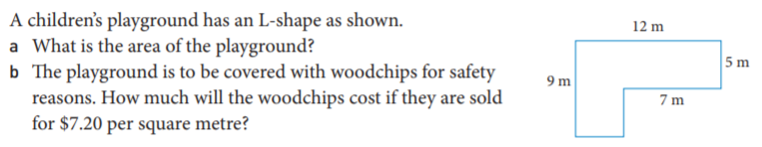
Worded questions
1.
2.

Slide 9
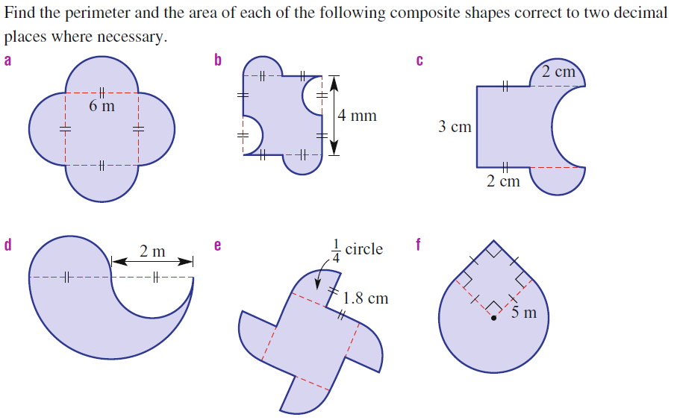
You do

Slide 10
Homework
Review your notes and write a summary answering the essential question.

